Slide 1
Smartdeliveryroute: Smart Delivery & Logistics System
Team Members:
• Tejas Thakor (Backend Lead)
• Ayush Kale (AI)
• Harshvarthini (Frontend)
• Subhashini Kandasamy (Frontend Lead)
• Mehek Fatima Sheikh (Frontend)
Date: 9 January 2026

Slide 2
Project Overview
Objective: To build a logistics platform that solves the 'visibility gap’
in last-mile delivery.
What is TrackMile? A web-based system connecting Fleet Managers and Drivers in real-time.
Core Value: Replaces manual phone calls with Live GPS Tracking and Automated Dispatching.
Key Innovation: Integrates Generative AI (Llama 3) to analyze driver performance automatically.

Slide 3
Problem Statement
The logistics industry faces critical challenges:
Lack of Visibility: Admins have zero real-time knowledge of driver locations.
Manual Errors: Assigning orders via phone leads to double-booking.
No Performance Data: Hard to identify efficient drivers without data.
Communication Gap: Drivers struggle to update statuses safely while driving.

Slide 4
Proposed Solution
TrackMile provides a centralized 2-module solution:
1. Centralized Dashboard: A Single Page Application (SPA) for Admins to manage the fleet.
2. Driver Mobile Console: A dedicated interface for accepting jobs and navigation.
3. Real-Time Sync: Instant updates via high-speed polling.
4. Smart Analytics: Automated revenue calculation and AI-driven reviews.

Slide 5
Technical Stack
We used a robust, modern tech stack:
• Frontend: React.js (Dynamic UI, Leaflet Maps)
• Backend: Java Spring Boot (REST API, Security)
• Database: MongoDB (NoSQL for flexible geolocation data)
• AI Engine: Groq API (Llama 3 Large Language Model)
• Tools: Postman (Testing), Maven (Build), Git (Version Control)

Slide 6
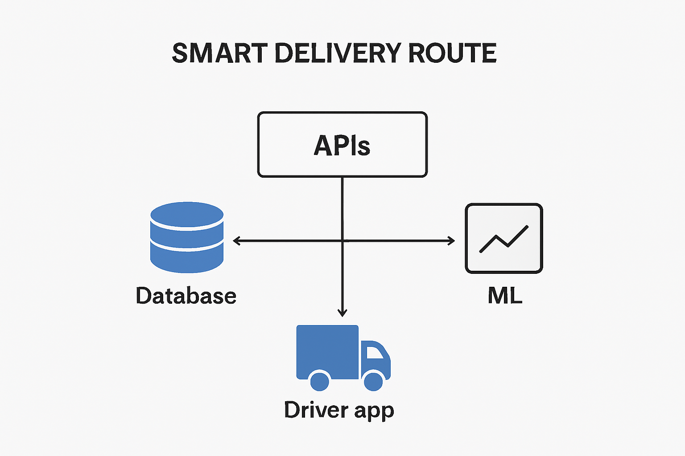
System Architecture
The data flow follows a Client-Server model:
1. React Client sends HTTP requests.
2. Spring Boot API processes logic & security.
3. MongoDB stores JSON data.
4. Groq AI processes history for reports.

Slide 7
Future Scope
To scale this project further, we plan to:
• WebSockets: Upgrade from Polling to WebSockets for sub-second updates.
• Mobile App: Convert React frontend to React Native for real GPS access.
• Route Optimization: Algorithms to auto-sort multiple stops for fastest delivery.

Slide 8
Conclusion
TrackMile successfully bridges the gap between manual logistics and automation.
Impact Delivered:
• 100% Visibility of active fleet.
• Reduced Dispatch Time via automated assignment.
• Data-Driven Decisions using AI insights.
Thank You! Questions?

